Slide 1
How Insightful!
Grok Your ASP.NET Core Web Apps with Application Insights

Slide 2


Hi! I’m Cam. I work for Microsoft.

Slide 3
What we’ll cover
What Application Insights is and why you need it
Instrumenting your app for Application Insights
Viewing Application Insights telemetry
Using telemetry in our ASP.NET Core app to solve:
A performance bottleneck
An unhandled exception

Slide 4
Why you need Application Insights
(Unless you don’t want to know what your application is doing)

Slide 5





Production troubleshooting

Slide 6
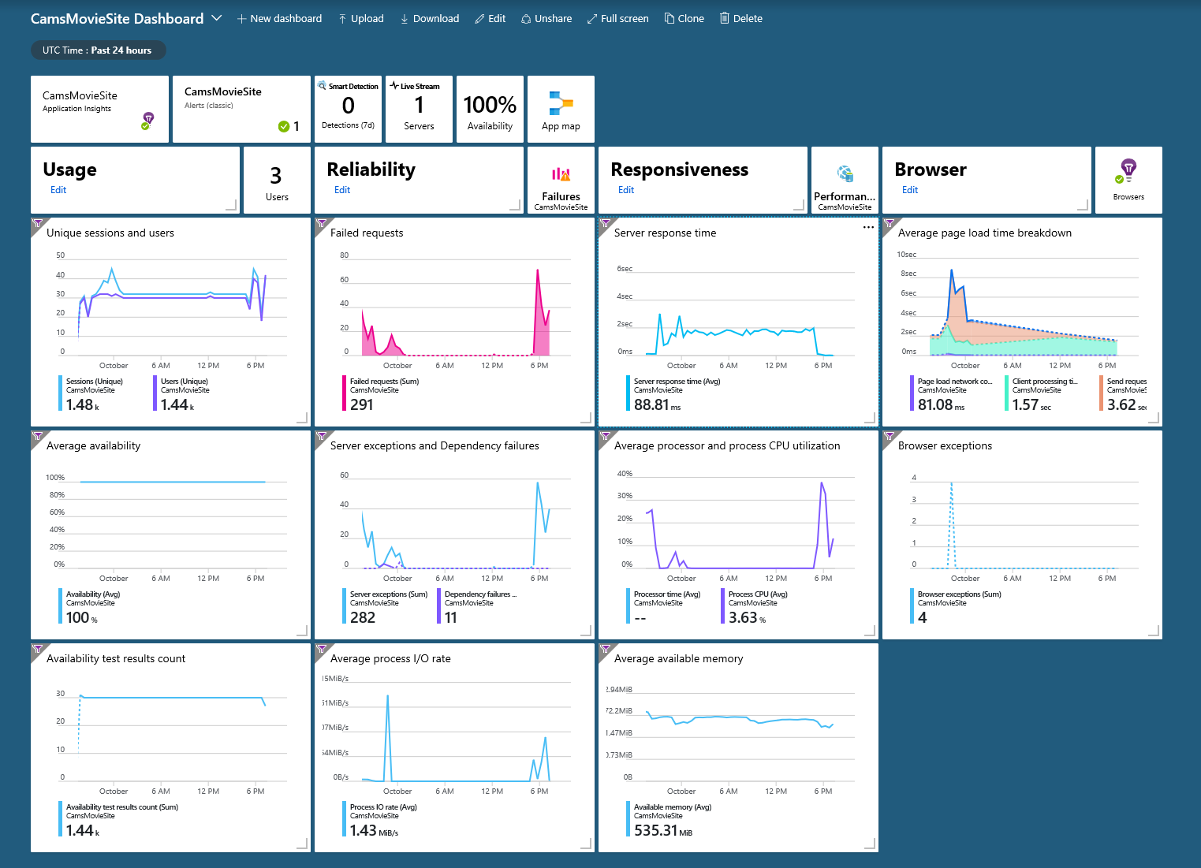
Insights at a glance

Slide 7

Where did you come from, where did you go?

Slide 8
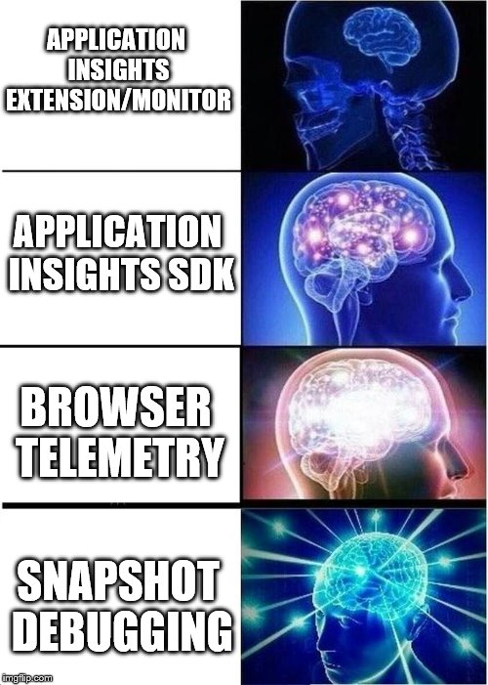
Instrumentation escalation

Slide 9
Demo – Instrumentation and Telemetry
Let’s wire it up and fix it!

Slide 10
Conclusion
We’re almost done!

Slide 11
What’s next?
https://github.com/camsoper/how-insightful
Things to check out next
Profiling (currently broken for ASP.NET Core 2.1)
Analytics (machine learning)
Alerts
Workbooks/Reports
API/Continuous Export
Excellent docs! https://docs.microsoft.com/azure/azure-monitor

Slide 12
Questions?

Slide 13
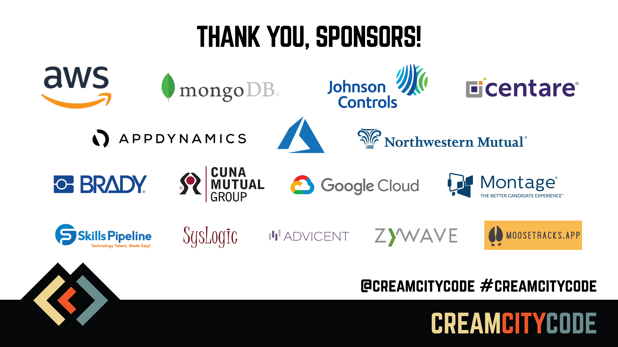

Slide 14


Thank you! @CamSoper CamSoper

